Slide 1
Following a Natural Disaster
A Social Narrative

Slide 2
Instructions for Using This Social Narrative Template
Anything italicized and in red is a place to insert pictures or update wording to match your student’s situation.
Be sure to look at the Notes section below the slides for additional instructions.
Work with your student’s school team to make any necessary updates to the narrative before sharing with your student.

Slide 3
Instructions for Using This Social Narrative Template
Remove this instruction page from the social narrative before printing/sharing with your student.
Social narratives work best when they include more descriptive than directive statements (two descriptive statements for every one directive statement). Descriptive statements share facts and feelings. Directive statements direct behavior or a student’s responses to situations.
For more information about how to write social narratives, visit https://tipsheets.vkcsites.org/how-to-write-a-social-story/.

Slide 4
(Insert picture of specific natural disaster that occurred.)
There was a big storm in my town. This is called a natural disaster.

Slide 5
(Insert pictures of natural disasters most likely to occur in that area.)
A natural disaster is when the weather gets so big, it causes a big mess all over my neighborhood.

Slide 6
(Insert photo of small storm.)
In small natural disasters, no one gets hurt, and the cleanup is easier.

Slide 7
(Insert picture of big storm.)
Sometimes natural disasters are big. People can get hurt, and areas can be so messy that they need to be rebuilt.

Slide 8
(Insert pictures of natural disasters most likely to occur in that area.)
Natural disasters can be scary, no matter how big or small they are.

Slide 9
(Insert pictures of natural disasters most likely to occur in that area.)
Even though it is okay to feel scared, natural disasters are no one’s fault. They happen in nature, outside of anyone’s control.

Slide 10
(Insert picture of child.)
I cannot control the weather, but I can try to control what I do after the storm.

Slide 11
(Insert pictures of places in your community your child likes.)
After the storm hits, there may be a big mess at my home, school, or park.

Slide 12
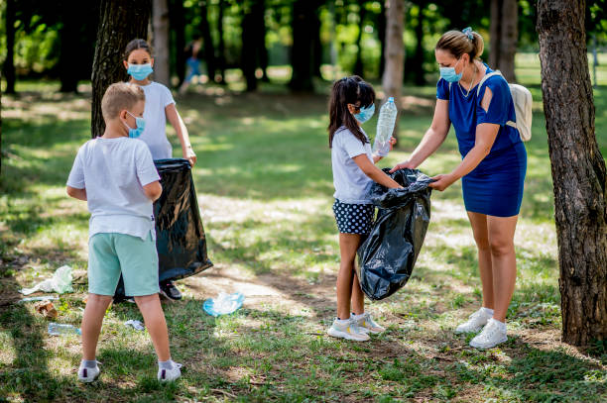
If there is a mess at a place I like to go to, then I can help clean up. It’s important to make sure these places are clean and safe before I go back.

Slide 13
(Insert picture of something child may have lost.)
I may lose something in the storm. I could lose things I like, places I like, or even people. It is okay to feel sad if I lose something.

Slide 14
(Insert picture of the child.)
Even though it is sad to lose something, safety is more important than things.

Slide 15
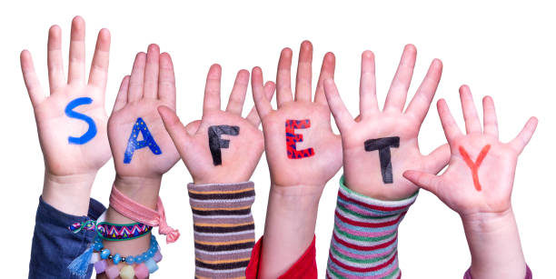
Being safe during a natural disaster is the most important thing.

